Slide 1

New ways of thinking about feedback for student learning
David Boud
Director, Centre for Research in Assessment and Digital Learning, Deakin University
Emeritus Professor, University of Technology Sydney
Notes:
Keynote
There has been a revolution in how feedback in higher education is conceptualised over the past decade. It has involved a shift from seeing feedback primarily as comments teachers provide to students about their work—an input—to a process in which students are necessarily involved throughout. How does this shift from what teachers do, to what students do, change how we organise feedback? Implications will be discussed: for the design of courses, for the relationship between assessment and feedback and how students’ feedback literacy can be developed.
Workshop
The workshop will draw directly on the ideas discussed in the keynote and explore the consequences of the changes in feedback thinking for everyday practice. It will focus on two issues. Firstly, on ways in which feedback processes can be structured into existing courses to maximise effects on student learning. Secondly, on designing activities that build students’ feedback literacy, so they can become more active learners without creating additional burdens on staff.
Please bring to the workshop the feedback challenges you face.
Programme:
10:00-10:30Doors open10:30-11:30Keynote with David Boud: New ways of thinking about feedback for student learning11:30-12:00Questions from the audience12:00-13:00Lunch for participants signed up for the following workshop13:00-15:00Workshop: New ways of thinking about feedback for student learning

Slide 2
Overview
The problem with feedback
The recent revolution in feedback thinking
What is feedback now?
Designing feedback that works
Building feedback literacy
Notes:
My ambition is not to provide you with some useful strategies—we will be dealing with a number of them as we progress—but more importantly new ways of thinking about feedback more helpful to student learning.
Want also to identify what are some fruitful areas for research: both small scale in terms of your own teaching, but also larger one that can potentially have great impact

Slide 3
1. The problem with feedback
Students complain that they do not get enough of it
Educators resent that after putting considerable time into generating feedback information, students take little notice of it
Educators typically think the information they provide is more useful than students think it is
Information is typically ‘telling’, often lacking strategies for improvement, and often lacking opportunities for further task attempts
Ende 1995, Hattie 2009, Boud and Molloy 2013, Johnson & Molloy 2017

Slide 4
The dilemma of feedback
Is it just a matter of doing what we do now just with more vigor and more systematically?
Is our use of the term feedback based on a misconception?
Notes:
Examples from Oxford and the OU

Slide 5
“what gets us into trouble is not what we don’t know.
It’s what we know for sure that just ain’t so”
attributed to Mark Twain

Slide 6

This is not feedback
“I left feedback on their assignments, which they never collected”

Slide 7
2. The revolution in feedback thinking
How has thinking changed over time?

Slide 8

What is the feedback revolution?
A major conceptual shift in the past eight years led by scholars in Australia, Hong Kong and the UK.
From a teacher-centric to a learning-centric perspective
Unless inputs (from others) lead to worthwhile effects on learning, feedback has not occurred, it is merely ‘hopefully useful information’.

Slide 9
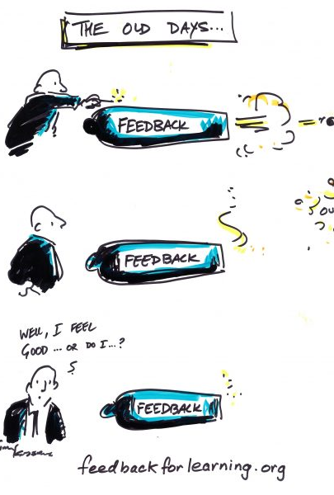
Evolution of feedback designs: Mark 0
Hopefully useful information
Given/done to receivers
  “The lecturer gave feedback to the student”
On completion of their work
(Boud & Molloy, 2013)

Slide 10
Evolution of feedback designs: Mark 1
Hopefully useful information
Given/done to receivers
Sequenced to require improvement
Given in time to allow for improved work
(Boud & Molloy, 2013)
Activity 3
Activity 2
Activity 1
Overlap of learning outcomes
Overlap of learning outcomes

Slide 11
Evolution of feedback designs: Mark 2
Feedback Mark 1 (ie. noticing student actions) plus:
  Strong student agency/participation
  Dialogic
  Multiple sources: Peers, self, experts
  Forward-looking focus on learning and change
  Emphasis on developing students’ evaluative judgement
  (Boud & Molloy, 2013)

Slide 12
3. What is feedback now?

Slide 13
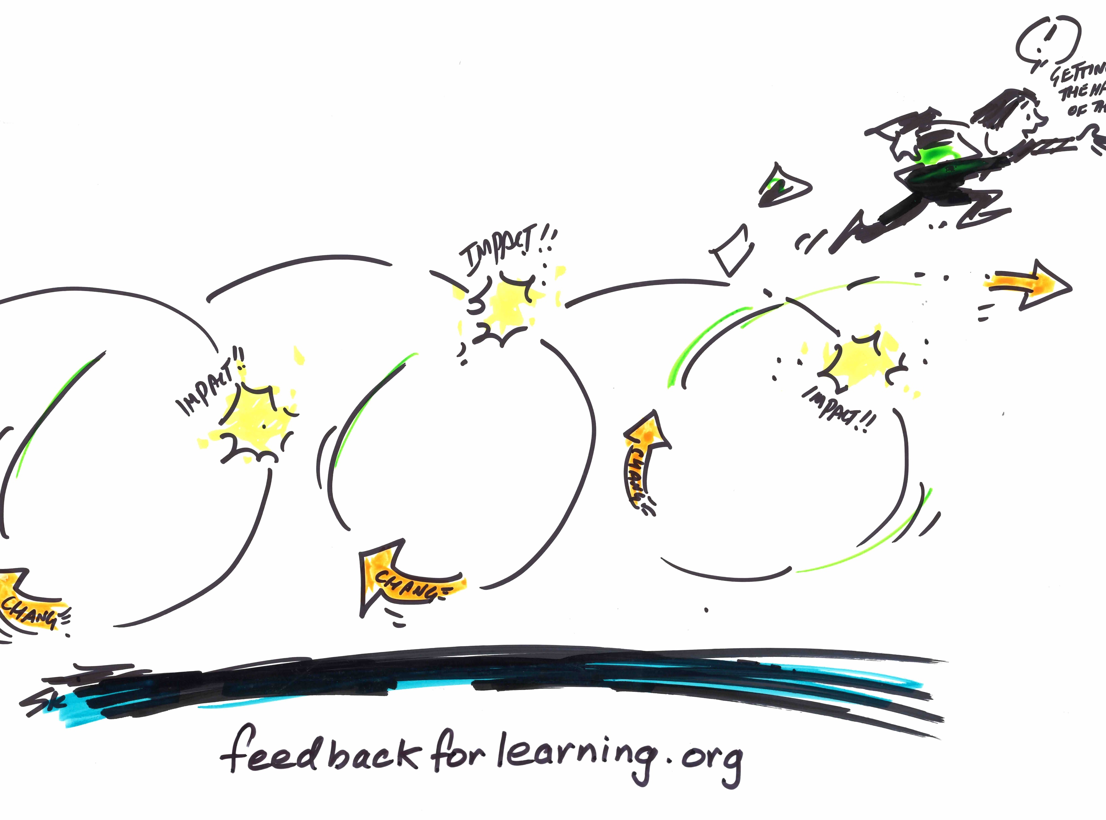
Need for a new definition
“Feedback is a process
in which learners make sense of information
about their performance
and use it
to enhance the quality of their work or learning strategies.”
This is feedback
Notes:
Suggest interaction with participants about the challenges inherent in this definition. Which parts are most challenging to them? Use the framework challenges to support this conversation.

Slide 14
4. Designing feedback that works

Slide 15
Examples of effective feedback practices
Survey with 4,514 student responses in two large universities identified examples of feedback working well
In-depth interviews with multiple teaching staff and students to understand what is occurring and why
Case studies of exemplars of effective feedback and lessons learnt in enabling feedback

Slide 16
Case studies of effective feedback
Developmental and diverse feedback:
helping first-year learners to transition into higher education
Personalised feedback at scale:
moderating audio feedback in first-year
In-class feedback:
a flipped teaching model in first-year
Authentic feedback through social media in second year
Layers and loops:
scaffolding feedback opportunities in first-year biology
Multiple prompt strategies across contexts:
feedback in classroom, lab and professional practice
Investing in educators:
enhancing feedback practices through the development of strong tutoring teams
feedbackforlearning.org

Slide 17
Questions for feedback design
Do learners know the purpose of feedback and their role(s) in it?
Can learners make sense of the information they receive?
Are mechanisms provided through which learners can take action?
What effects should we be looking for to ensure the feedback process has worked?
From Henderson, M., Molloy, E. ,Ajjawi, R.,and Boud, D.,(2019). Designing feedback for impact. In Henderson, M., Ajjawi, R., Boud, D., and Molloy, E. (Eds.) The Impact of Feedback in Higher Education. London: Palgrave Macmillan, 267-285.

Slide 18
Designing opportunities for feedback
Start with the student
Provide opportunities for action
Build early feedback opportunities
Construct feedback-rich environments
Facilitate co-construction of understanding between learners and others
Encourage multi-source feedback
Explicitly prepare learners to acknowledge and work with affect in feedback
Henderson, M., Molloy, E. ,Ajjawi, R.,and Boud, D.,(2019)..

Slide 19
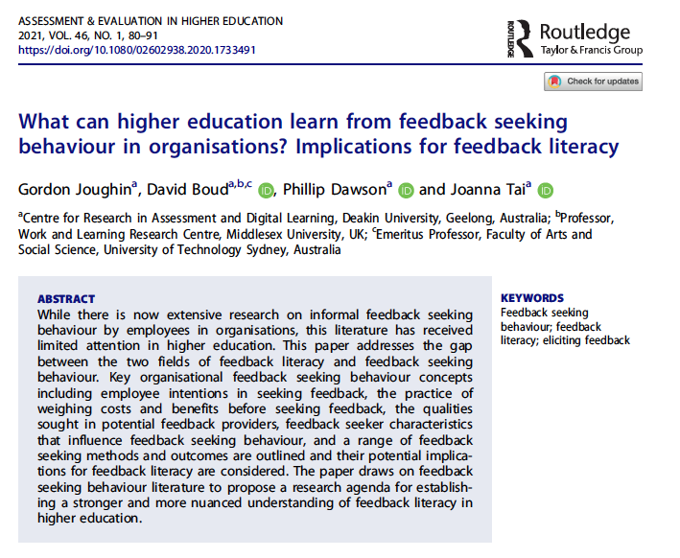
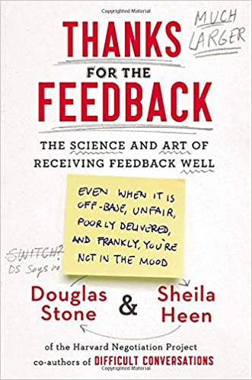
Train students in eliciting feedback
Feedback seeking behaviour is well established in the business literature

Slide 20
Is this enough to improve feedback?
While it is the overall feedback process that makes a difference,
the information we communicate to learners is still very important.
However,
Some kinds of comments lead to negative outcomes
Many feedback processes do not lead to improved learning

Slide 21
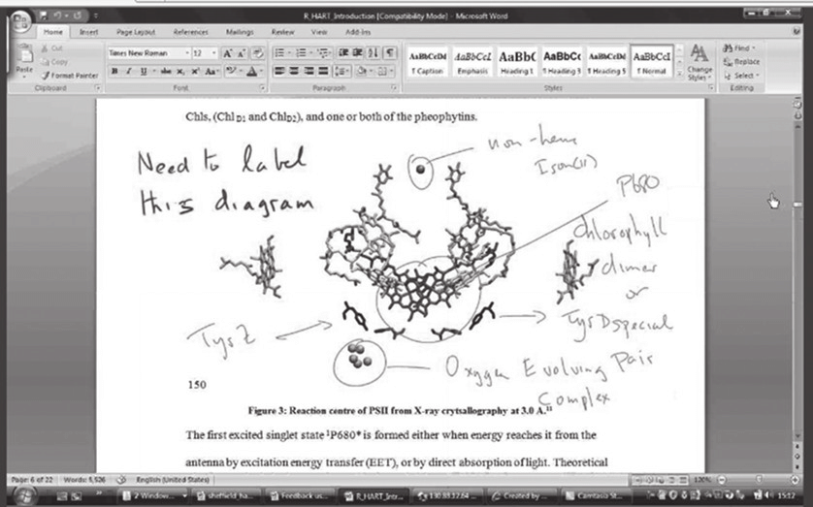
Alternatives to written comments
There are many modes for feedback comments with various pros and cons:
Group comments
  Students don’t see these as feedback
  Not oriented to individual student needs
Face-to-face by appointment
  No time to do this for everyone
  The wrong students benefit when it is offered
Video (or audio) file of comments
  More personal and nuanced than written
  Saves time
Screencast plus audio comments file
  Needed for technical/visual assignments
https://www.researchgate.net/publication/328336801_Combining_screencasting_and_a_Tablet_PC_to_deliver_personalised_student_feedback/figures?lo=1

Slide 22
An important distinction
Mark justification
Judgements and comments about what students have completed
Essentially backward-looking
Feedback information
Comments about what students can do to improve their work
Essentially forward-looking

Slide 23
Ten feedback strategies to make a difference
Build in a following task where students can apply feedback information from the first task
Have students identify and state what kind of comments they would like on their work
Have students respond to feedback information with a plan for what they are going to do about it
Have students judge their work against criteria or a rubric before they hand it in
Facilitate peer feedback sessions
Distinguish between mark justification and feedback information when making comments
Move detailed feedback comments from late in the semester to earlier when students can act of them
Focus on comments for improvement rather than corrections
Focus on models and exemplars of good work
Train students to be feedback literate (ie. What feedback is and how they can make it work)
Draw inspiration and find many more strategies from the case studies of excellent practice at feedbackforlearning.org

Slide 24
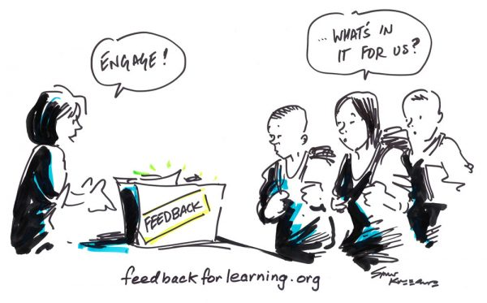
5. Building feedback literacy
Do we know what students need to understand about feedback and how it operates?
Do they know?

Slide 25
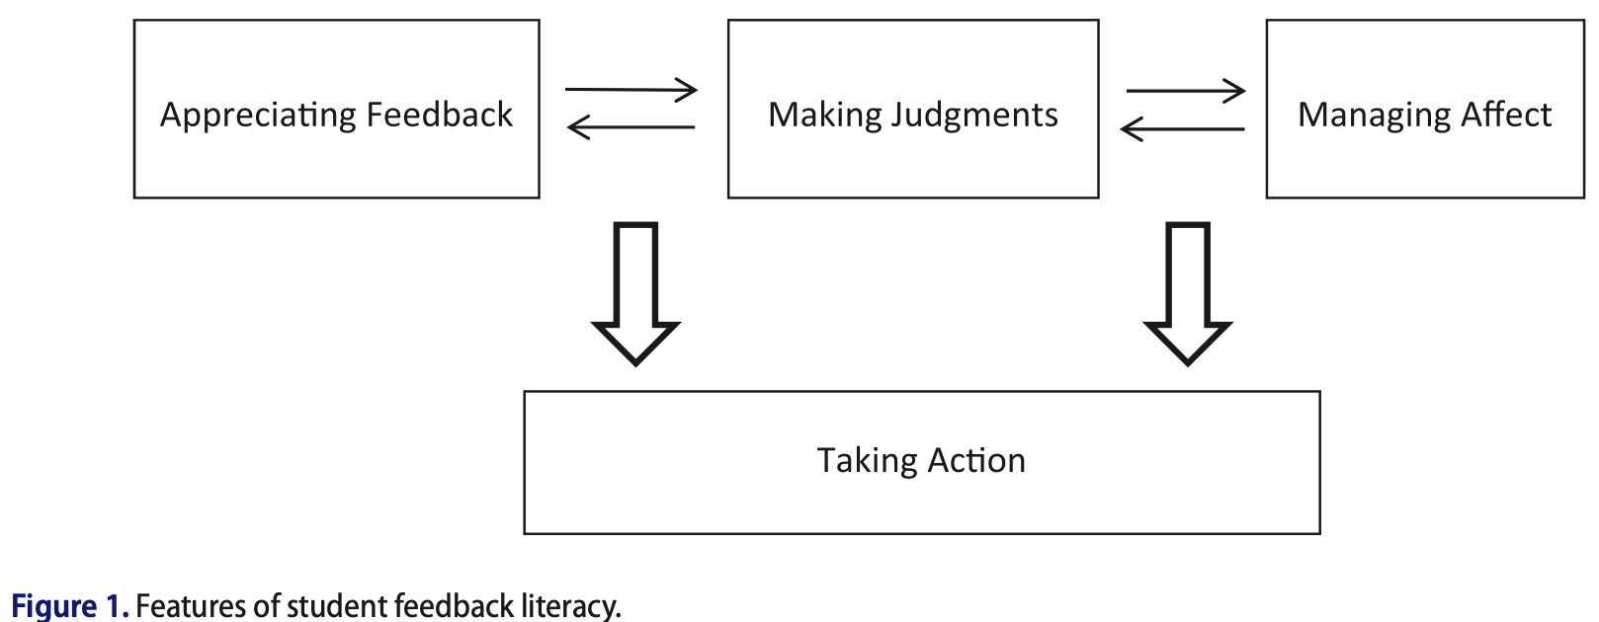
The notion of feedback literacy
Feedback literacy:
“the understandings, capacities and dispositions needed to make sense of information and use it to enhance work or learning strategies”.
Key features identified:
appreciating feedback
making judgments
managing affect
taking action.
    Carless and Boud (2018)

Slide 26
Learner feedback literacy competencies
Approach
Secondary analysis of a large student survey (n=4514) and focus groups to explore student responses to feedback practices
Looked for expressions/indicators of feedback
Iterative development of framework items checking against student views
Molloy, Boud and Henderson (2020)

Slide 27
The Learner Feedback Literacy Framework
A learner exhibiting well developed feedback literacy:
Section 1: Commits to feedback as improvement
Section 2: Appreciates feedback as an active process
Section 3: Elicits information to improve learning
Section 4: Processes feedback information
Section 5: Acknowledges and works with emotions
Section 6. Acknowledges feedback as a reciprocal process
Section 7: Enacts outcomes of processing of feedback information
Molloy, Boud and Henderson (2020)

Slide 28
Ways of using the framework
Build in the development of feedback literacy to all first-year activities
Position students as active eliciting learners throughout all pedagogic activities
Identify why some students don’t seem to benefit from feedback comments
Further research is underway to develop an instrument to enable:
  tracking of feedback literacy to be tracked over time
  evaluation of tasks designed to build feedback capabilities
  [available soon]

Slide 29
Mechanisms for embedding feedback literacy
Eliciting
Processing
Enacting

Slide 30
We need feedback literacy ourselves
At the macro-level
in the design of entire programs
At the meso-level
to design course units/subjects
At the micro-level
to design appropriate inputs to individual students

Slide 31
Teacher feedback literacy
 | Teacher Feedback Literacy (Boud & Dawson, 2021)
Macro | 1. Plans feedback strategically
 | 2. Uses available resources well
 | 3. Creates authentic feedback-rich environments
 | 4. Develops student feedback literacy
 | 5. Develops/coordinates colleagues
 | 6. Manages feedback pressures (for self and others)
 | 7. Improves feedback processes
Meso | 8. Maximises effects of limited opportunities for feedback
 | 9. Organises timing, location, sequencing of feedback events
 | 10. Designs for feedback dialogues and cycles
 | 11. Constructs and implements tasks and accompanying feedback processes
 | 12. Frames feedback information in relation to standards and criteria
 | 13. Manages tensions between feedback and grading
 | 14. Utilises technological aids to feedback as appropriate
 | 15. Designs to intentionally prompt student action
 | 16. Designs feedback processes that involve peers and others
Micro | 17. Identifies and responds to student needs
 | 18. Crafts appropriate inputs to students
 | 19. Differentiates between varying student needs
What feedback literate teachers do: an empirically-derived competency framework
Boud and Dawson

Slide 32
Key points about feedback
It has a powerful effect on learning
It is one of very few ways in which courses are tailored to the individual needs of students
Feedback processes need to be carefully designed around what students do
  Giving comments to students is only part of a feedback process
  Without active involvement from students, inputs can’t influence learning
  Unless the loop is completed, feedback has not occurred
It should always be judged in terms of its effect on student learning

Slide 33
References
Ajjawi, R. and Boud, D. (2018). Examining the nature and effects of feedback dialogue, Assessment and Evaluation in Higher Education, 43, 7, 1106–1119 .
Ajjawi, R., Kent, F., Broadbent, J., Tai, J., Bearman, M., and Boud, D. (published online 2 March 2021). Feedback that works: A realist review of feedback interventions for written tasks, Studies in Higher Education, DOI: 10.1080/03075079.2021.1894115
Boud, D. and Dawson, P. (published online 19 April 2021). What feedback literate teachers do: an empirically derived competency framework, Assessment and Evaluation in Higher Education, DOI:10.1080/02602938.2021.1910928
Boud, D. and Molloy, E. (2013). Rethinking models of feedback for learning: the challenge of design. , Assessment and Evaluation in Higher Education, 38, 6, 698-712
Carless, D. and Boud, D. (2018). The development of student feedback literacy: enabling uptake of feedback, Assessment and Evaluation in Higher Education, 43, 8, 1315-1325.
Dawson, P., Henderson, M., Mahoney, P., Phillips, M., Ryan, T., Boud, D. and Molloy, E. (2019). What makes for effective feedback: staff and student perspectives, Assessment and Evaluation in Higher Education, 44, 1, 25-36.
Hattie, J. and Timperley, H. (2008). The power of feedback’, Review of Educational Research, 77: 81-112.
Henderson, M., Ryan, T., Boud, D., Dawson, P., Phillips, M., Molloy, E. and Mahoney, P. (2019). Conditions that enable effective feedback, Higher Education Research and Development, 38, 7, 1401-1416.
Henderson, M., Ryan, T., Boud, D., Dawson, P., Phillips, M., Molloy, E. and Mahoney, P. (2021). The usefulness of feedback, Active Learning in Higher Education , 22, 3, 2290243.
Hoo, H-T., Deneen, C. and Boud, D. (published online 1 June 2021). Developing student feedback literacy through self and peer assessment interventions, Assessment and Evaluation in Higher Education, DOI: 10.1080/02602938.2021.1925871
Jensen, L., Bearman, M. and Boud, D. (published online 3 July 2021) Understanding feedback in online learning: a critical review and metaphor analysis, Computers and Education, 173, 104271. DOI: 10.1016/j.compedu.2021.104271
Joughin, G., Boud, D., Dawson, P. and Tai, J. (2021). What can higher education learn from feedback seeking behaviour in organisations? Implications for feedback literacy, Assessment and Evaluation in Higher Education, 46, 1, 80-91.
Malecka, B., Ajjawi, R., Boud, D. and Tai, J. (published online 26 August 2021). An empirical study of student action from ipsative design of feedback processes, Assessment and Evaluation in Higher Education, DOI: 10.1080/02602938.2021.1968338
Malecka, B., Boud, D. & Carless, D. (published online 12 May 2020). Eliciting, processing and enacting feedback: Mechanisms for embedding student feedback literacy within the curriculum, Teaching in Higher Education, DOI: 10.1080/13562517.2020.1754784
Malecka, B. and Boud, D. (published online 17 May 2021). Fostering student motivation and engagement with feedback through ipsative processes, Teaching in Higher Education, DOI: 10.1080/13562517.2021.1928061
Molloy, E., Boud, D. and Henderson, M. (2020) Developing a learner-centred framework for feedback literacy, Assessment and Evaluation in Higher Education, 45, 4, 527-540.
Nieminen, J., Tai, J., Boud, D. and Henderson, M. (published online 21 February 2021). Student agency in feedback: beyond the individual, Assessment and Evaluation in Higher Education, DOI: 10.1080/02602938.2021.1887080
Tai, J., Ajjawi, R., Boud, D., Dawson, P. and Panadero, E. (2018). Developing evaluative judgement: enabling students to make decisions about the quality of work, Higher Education, 76:467–481
Winstone, N. E., Ajjawi, R., Dirkx, K. and Boud, D. (published online 29 April 2021). Measuring what matters: the positioning of students in feedback processes within national student satisfaction surveys, Studies in Higher Education, DOI: 10.1080/03075079.2021.1916909
Winstone, N. and Boud, D. (2019). Exploring cultures of feedback practice: The adoption of learning-focused feedback practices in the UK and Australia. Higher Education Research and Development, 38, 2, 411-425.
Winstone, N. E., Boud, D., Dawson. P. and Heron, M. (published online 7 April 2021). From feedback-as-information to feedback-as-process: a linguistic analysis of the feedback literature, Assessment and Evaluation in Higher Education, DOI: 10.1080/02602938.2021.1902467
Winstone, N. E., R. A. Nash, M. Parker, and J. Rowntree. (2017). Supporting Learners' Agentic Engagement With Feedback: A Systematic Review and a Taxonomy of Recipience Processes. Educational Psychologist, 52 (1):17-37.
Winstone, N.E. & Boud, D. (published online 16 June 2020). The need to disentangle assessment and feedback in higher education, Studies in Higher Education, DOI: 10.1080/03075079.2020.1779687

Slide 34
A learner exhibiting well developed feedback literacy:
Group 1: Commits to feedback as improvement
Establishes a disposition to use feedback to continually improve their work
Acknowledges that mastery/expertise is not fixed, but can change over time and context
Group 2: Appreciates feedback as an active process
Acknowledges the role of feedback processes in improving work and refining judgements and learning strategies
Recognises that effective learners are active in identifying their own learning needs
Anticipates their own learning needs and communicates these to appropriate others
Understands the role of standards and criteria in judging the work of oneself and others
Identifies that they need to complete a feedback loop for information provided by others to be effective
Recognises that feedback should build capacity to develop their own evaluative judgment over time and over different learning outcomes
Group 3: Elicits information to improve learning
Realises that feedback requires active elicitation and does not wait for others to provide unsolicited information
Uses a wide repertoire of strategies to elicit appropriate information from others to assist learning
Considers feedback from multiple sources—eg. teachers, trainers, peers, practitioners, consumers— to provide a different scope and opportunities for learning
Recognises that different stakeholders may have different perspectives, experience and levels of investment in the process
Engages in dialogue to elicit useful information about standards, criteria and the nature of good work
Seeks out exemplars as a way to make sense of standards of work
Seeks cues from the environment and the task itself that indicate the appropriateness of work

Slide 35
A learner exhibiting well developed feedback literacy:
Group 4: Processes feedback information
Identifies and utilizes standards, criteria and exemplars
Recognises and interprets language peculiar to education containing important cues about the task or related outcomes
Selectively accepts and rejects views of others in coming to their own appraisals
Extracts key actionable information from others, which may require prompting for more detail or clarity
Group 5: Acknowledges and works with emotions
Demonstrates volition and sensitivity in approaching suitable others to elicit suggestions and to continue dialogue with them as needed
Demonstrates openness to receiving comments from others without displaying defensiveness
Builds trust in facilitating honest and meaningful information exchanges with others
Recognises that feedback information comes in different modes with different capacities to mobilise emotions, eg. individual and group, written and through various other media, structured and informal
Manages the emotional challenges of receiving and sifting information which may be unwelcome or misjudged
Considers the influence of high stakes assessment on the way learners might engage in candid dialogue about their own performance, eg. declaring their own deficiencies in performance may impact on grades, or desire to score well may reduce learners’ receptivity to feedback information
Group 6. Acknowledges feedback as a reciprocal process
Recognises that they have roles as both user and provider of information and that skill in one role helps in the other
Composes useful information for others about the nature of their work
Exhibits cultural sensitivity through not assuming that others are likely to react in the same way as oneself in receiving and responding to information
Group 7: Enacts outcomes of processing of feedback information
Responds to feedback information from others through goal-setting and planning how it might be utilized in future work
Analyses and records information in appropriate forms for the purposes of acting on it subsequently
Monitors their own progress to discern where feedback might be helpful and to influence the setting of new learning goals

Slide 36
Implications of ChatGPT and similar AI for assessment
What do GPTs do? They:
  assemble information from large data banks to answer queries in standard language
  do not exhibit creativity or address problems that have not already been solved
  will become a normal tool in all human endeavours, just like a search engine
Currently, they have some limitations, but these will be resolved in the next few years
  eg they are poor at referencing
They challenge assessors to have learning outcomes that can’t be addressed by AI and to ask meaningful questions to judge students with respect to these
What are we really assessing? Are the questions best answered by GPT what we most want students to do in their assignments?
Why should we ever bother testing students on something they can just ‘GPT’?
We have to face the challenge of cognitive off-loading for all work in society
Notes:
Generative Pre-trained Transformer

